Slide 1

CS-310 Scalable Software Architectures
Lecture 2:
HTTP and Web Servers
1
Steve Tarzia

Slide 2
Last Time: Types of Scaling
A software service is a program that runs continuously, giving responses to requests.
Scalability is the ability of a service to grow to handle many concurrent users (ideally an arbitrarily large number).
Two approaches to scaling that are useful in different scenarios:
Vertical scaling is upgrading your machine(s).
  The simplest and most efficient way of scaling… but there is a ceiling.
Horizontal scaling is adding more machines.
  Coordinating a cluster of machines is complicated, but it's necessary for global scale and massive throughput.

Slide 3
How are services different than programs?
3
STOP
and
THINK

Slide 4
Basic Service Definition
4
In the theory of computation, a computer program (Turing Machine) takes a symbolic input and returns a symbolic output. Then it stops.
Similarly, a computer service receives requests and returns a response for each request.
However, a service can handle many concurrent, independent requests, which may be from different users.

Slide 5
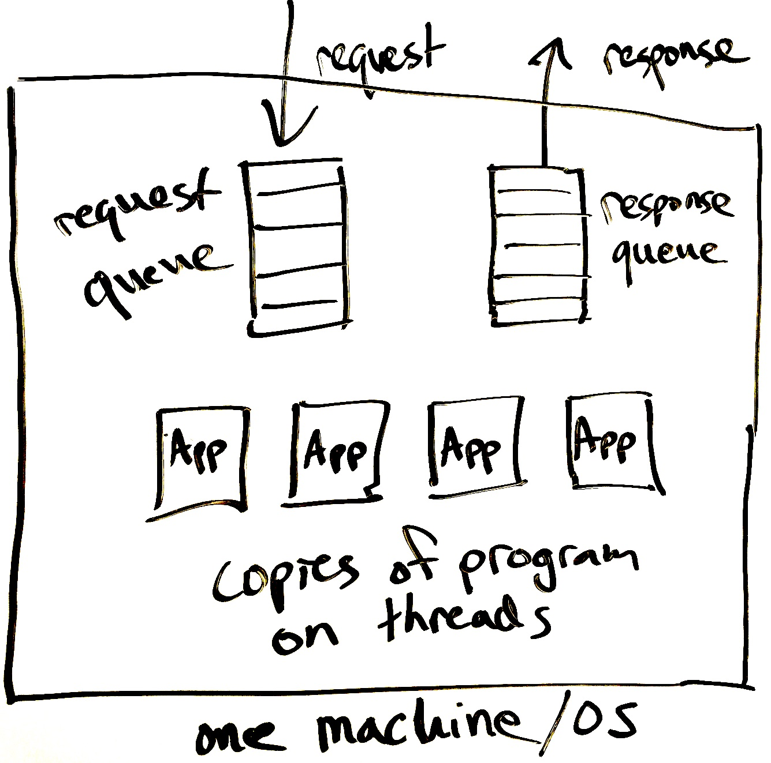
From a Program to a Service
Network
5
A simple computer program can be translated into a service by:
  Listening to requests that arrive from the network.
  Running many copies of the program concurrently
  (using the OS features called threads or processes).
  Using queues to store unhandled requests and unsent responses.
    Queues allow competing threads to share a single network “socket” (one IP address and port).

Slide 6
Service thread
6
The program on each thread runs an infinite loop:
while(true){
request = requestQ.pop();
response = doWork(request);
responseQ.push(response);
}
pop() waits if the queue is empty.
push() might wait if queue is too full.
A thread that waits is also said to block.
push
pop

Slide 7
Concurrency
7
Many requests can be processed at the same time (concurrently).
This allows many CPU cores to be used in parallel.
The threaded design is also helpful even if there is only one CPU core, because the app may block to request data from disk or over the network.
  This is called IO (input/output).
While one thread is waiting for the IO to complete, another can use the CPU.

Slide 8
Web/HTTP server frameworks
8
Web/HTTP server software provides this basic framework.
For example:
  Java: Jetty, Tomcat
  Python: Flask, Django
  Javascript: Node.js
  Static files: Apache httpd, Nginx
Just plug in the app code.

Slide 9
Hyper Text Transport Protocol (HTTP)
HTTP is a client-server data exchange protocol
It was invented for web browsers to fetch pages from webservers
Request specifies:
  A human-readable header with: URL, method, (plus some optional headers)
  An optional body, storing raw data (bytes).
Response includes:
  A human-readable header with response code, (plus some optional headers)
  An optional body

Slide 10
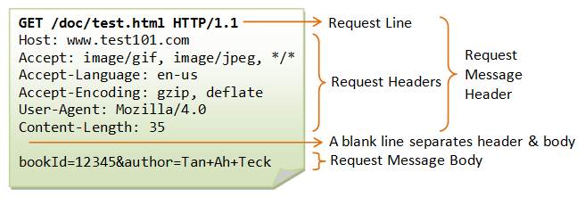
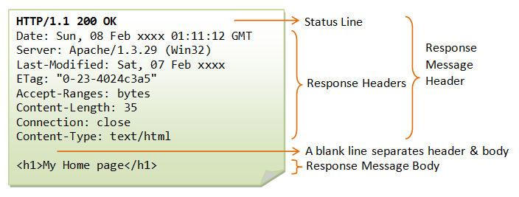
Request:
(optional for GET)
Response:
From https://www.ntu.edu.sg/home/ehchua/programming/webprogramming/HTTP_Basics.html

Slide 11
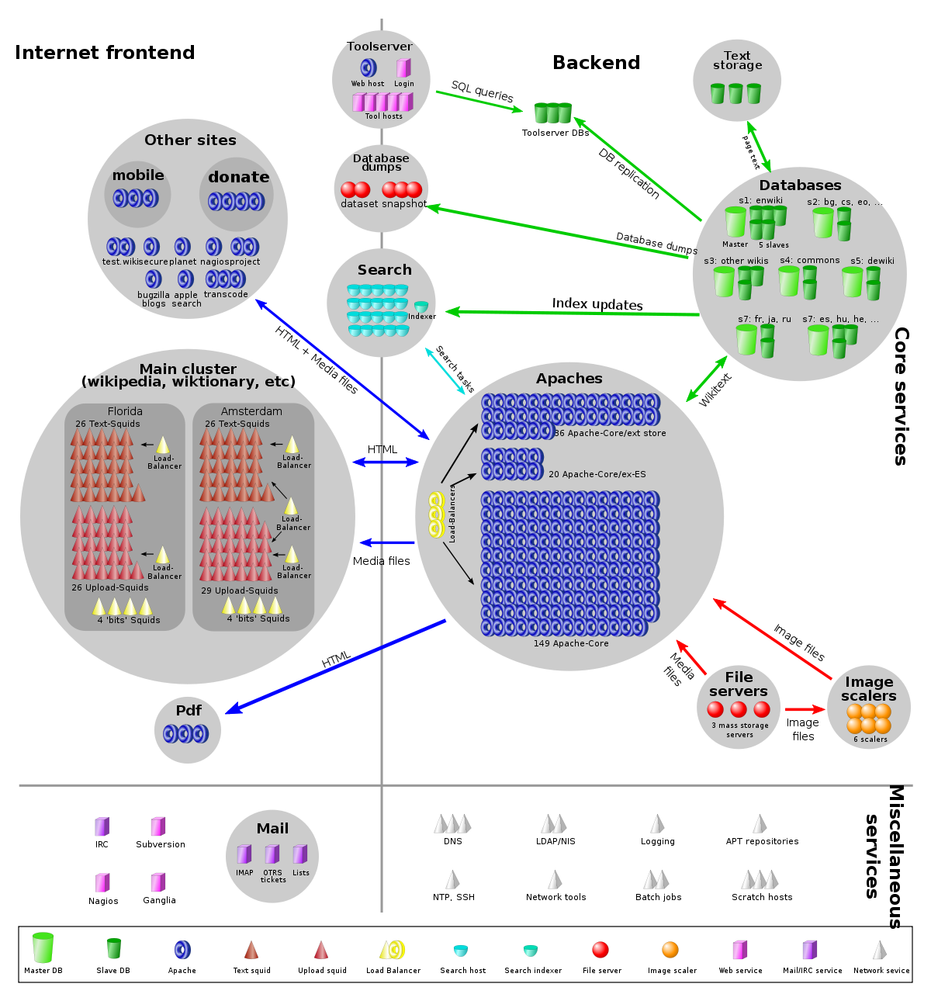
Wikipedia architecture
11
Main application is MediaWiki
70% PHP, 30% JavaScript
Databases are MariaDB (SQL)
https://meta.m.wikimedia.org/wiki/Wikimedia_servers

Slide 12
Key parts
12
Squid: Caching HTTP proxy on frontend.
Apache httpd: web servers running the main application (MediaWiki)
SQL databases for wiki text, etc.
File servers for images.

Slide 13
Key parts
13
HTTP cache
MediaWiki
Your browser

Slide 14
Caching layer is optional!
14
We’ll come back to caching in the next lecture
MediaWiki
Your
web browser

Slide 15
MediaWiki application
15
Runs PHP code in Apache Httpd web framework.
Input request:
  An HTTP request from the browser.
  For example, GET /wiki/Embioptera
Output response:
  An HTTP response understandable to the browser.
  Usually an HTML document, sometimes an image, etc.

Slide 16
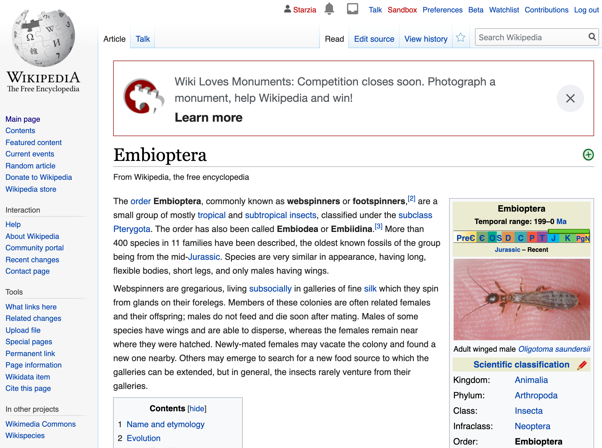
MediaWiki’s main task is to generate article HTML
16
How?
Get corresponding wiki text from DB.
Translate wiki text to HTML.
Add wrapping content and banners.
Add user-specific page header, based on cookies in request.

Slide 17
MediaWiki’s main task is to generate article HTML
17
How?
Get corresponding wiki text from DB.
Translate wiki text to HTML.
Add wrapping content and banners.
Add user-specific page header, based on cookies in request.

Slide 18
MediaWiki’s main task is to generate article HTML
18
How?
Get corresponding wiki text from DB.
Translate wiki text to HTML.
Add wrapping content and banners.
Add user-specific page header, based on cookies in request.

Slide 19
MediaWiki’s main task is to generate article HTML
19
How?
Get corresponding wiki text from DB.
Translate wiki text to HTML.
Add wrapping content and banners.
Add user-specific page header, based on cookies in request.

Slide 20
Code walkthroughs
(Bitbucket links will not work for students, refer to video)
https://stevetarzia.com/
  https://bitbucket.org/starzia/www.stevetarzia.com/src/master/index.php?mode=view&spa=0&at=master&fileviewer=file-view-default
https://stevetarzia.com/xmas/
  https://bitbucket.org/starzia/www.stevetarzia.com/src/master/xmas/index.php?mode=view&spa=0&at=master&fileviewer=file-view-default
https://stevetarzia.com/listen/
  https://bitbucket.org/starzia/www.stevetarzia.com/src/master/listen/index.php?mode=view&spa=0&at=master&fileviewer=file-view-default
https://gunmemorial.org/donate
  https://bitbucket.org/starzia/gunmemorial/src/master/victim-portal/src/main/webapp/donate.jsp?mode=view&spa=0&at=master&fileviewer=file-view-default
https://gunmemorial.org/sitemap.txt
https://gunmemorial.org/sitemap.txt?startYear=2020&endYear=2020
  https://bitbucket.org/starzia/gunmemorial/src/master/victim-portal/src/main/java/org/gunmemorial/web/servlet/SiteMapServlet.java?mode=view&spa=0&at=master&fileviewer=file-view-default

Slide 21
Recap
Showed that web server frameworks let you translate a simple program into a multi-threaded service with concurrency.
Introduced HTTP as the most common type of service.
  Client requests a document (specified in path/url)
  Server sends document in the response.
High-level overview of Wikipedia’s architecture.
Open questions:
What’s caching and why is it possible?
What’s the purpose of the database and how to make it scalable?

