Slide 1

CS-310 Scalable Software Architectures
Lecture 1:
Types of Scaling
Steve Tarzia

Slide 2
Gaps in traditional CS curriculum
In the first few CS classes, students learn all about writing programs.
  These are single-machine, and single-threaded.
  Take an input and produce an output.
  Goals are: correctness, efficiency, (and hopefully clarity or readability).
After that, most of the upper-level classes are introductions to various computing research fields.
  These are conceptually difficult, but involve only very small programs.
  This is preparation for a PhD program, not for Software Engineering.
The Result: most CS graduates are not ready to be productive in even a junior-level software engineering job.

Slide 3
What you’ll learn in this class
In short, you’ll learn to build real, complex, big software services.
  Eg., how to build something like Google Search or Netflix.
  Writing correct & efficient code is only a small part of the challenge.
Learn about:
  Coordinating multiple apps
  Scaling load
  Big data storage and processing
  Operating in the cloud, and different computing platform models
  … and more.
The Goal: to learn enough to build your own scalable startup product.
Bypass the “on the job training” or self-study usually required.

Slide 4
Topics we’ll cover
Control:
Separation of concerns: Microservices, APIs
Asynchronicity: Distributed Message Queues, Push Notifications
Parallel processing: Load balancing, Map Reduce, Spark
Platforms: Cloud computing, VMs, Containers, Serverless functions
Data Storage:
Relational vs NoSQL databases
Caching, Content Delivery Networks (CDNs)
Case Studies:
Wikipedia, Netflix, Twitter, etc.
We’ll look at a small piece of each of these companies’ architecture.

Slide 5
What you will not learn
Machine learning
Database internals
Cloud infrastructure internals (virtualization, SDN)
Distributed systems details

Slide 6
What you’ll learn in this class
In short, you’ll learn to build real, complex, big software services.
  Eg., how to build something like Google Search or Netflix.
  Writing correct & efficient code is only a small part of the challenge.
Learn about:
  Coordinating multiple apps
  Scaling load
  Big data storage and processing
  Operating in the cloud, and different computing platform models
  … and more.
The Goal: to learn enough to build your own scalable startup product.
Bypass the “on the job training” or self-study usually required.

Slide 7
What you will not learn
Machine learning
Database internals
Cloud infrastructure internals (virtualization, SDN)
Distributed systems details

Slide 8
Topics we’ll cover
Service Oriented Architectures (Microservices)
Relational vs NoSQL databases
Caching, Content Delivery Networks (CDNs)
Distributed Message Queues
Parallel processing with: Map Reduce, Spark
Case Studies:
Wikipedia, Netflix, Twitter, etc.
We’ll look at a small piece of each of these companies’ architecture.

Slide 9
Today's introduction
Differences between standalone apps and services.
What do we mean by “scalability” and why is it difficult?

Slide 10
Traditional view of Software Scalability
In Data Structures & Algorithms we consider a kind of scalability:
As input data size “n” gets bigger, program should run quickly.
Complexity analysis lists program runtime as a function of input size.
For example:
Given a list of size n, mergesort takes O(n log n) time to run.
Given a hashtable of size n, finding a value takes O(1) time.
This assumes one problem to solve, one computer, and all operations having the same cost.

Slide 11
Services vs Programs
A service is different than a simple program because it listens for requests from clients/users, and may handle multiple requests concurrently.
External user provides an input (request) and service outputs a response.
Requests are usually delivered as messages that arrive over a network.
The service runs constantly, waiting for requests that it should process.
  Thus, you can’t just run the code on your laptop. You need a machine that is always powered-on (probably located in a data center or server room).
For example:
a website, like: https://www.ebay.com/sch/i.html?_nkw=guitar

Slide 12
Defining Service Scalability
Roughly speaking, a service is scalable if it can easily handle growth in the number of concurrent users/requests.
Scalability metrics are measures of work throughput:
Requests/queries per second
Concurrent users
Monthly-active users
So far, we don’t care about the costs to achieve this scale (time per request or number of machines required), just the scale achieved.

Slide 13
Scaling Challenges
STOP
and
THINK
Why is it difficult to make services big, even if money ain’t a thang?
Programs run on one machine, which has limited speed.
Coordinating multiple machine can be difficult (who does what?)
Sharing data among multiple machines is difficult (where is the data? how do we manage competing requests to change the same data?).
More machines means there is high probability one will fail (die).
Users can be distributed worldwide (communication latency is high).
Service components must trust each other but ignore interference from attackers (authentication).
Software updates must be deployed without downtime.

Slide 14
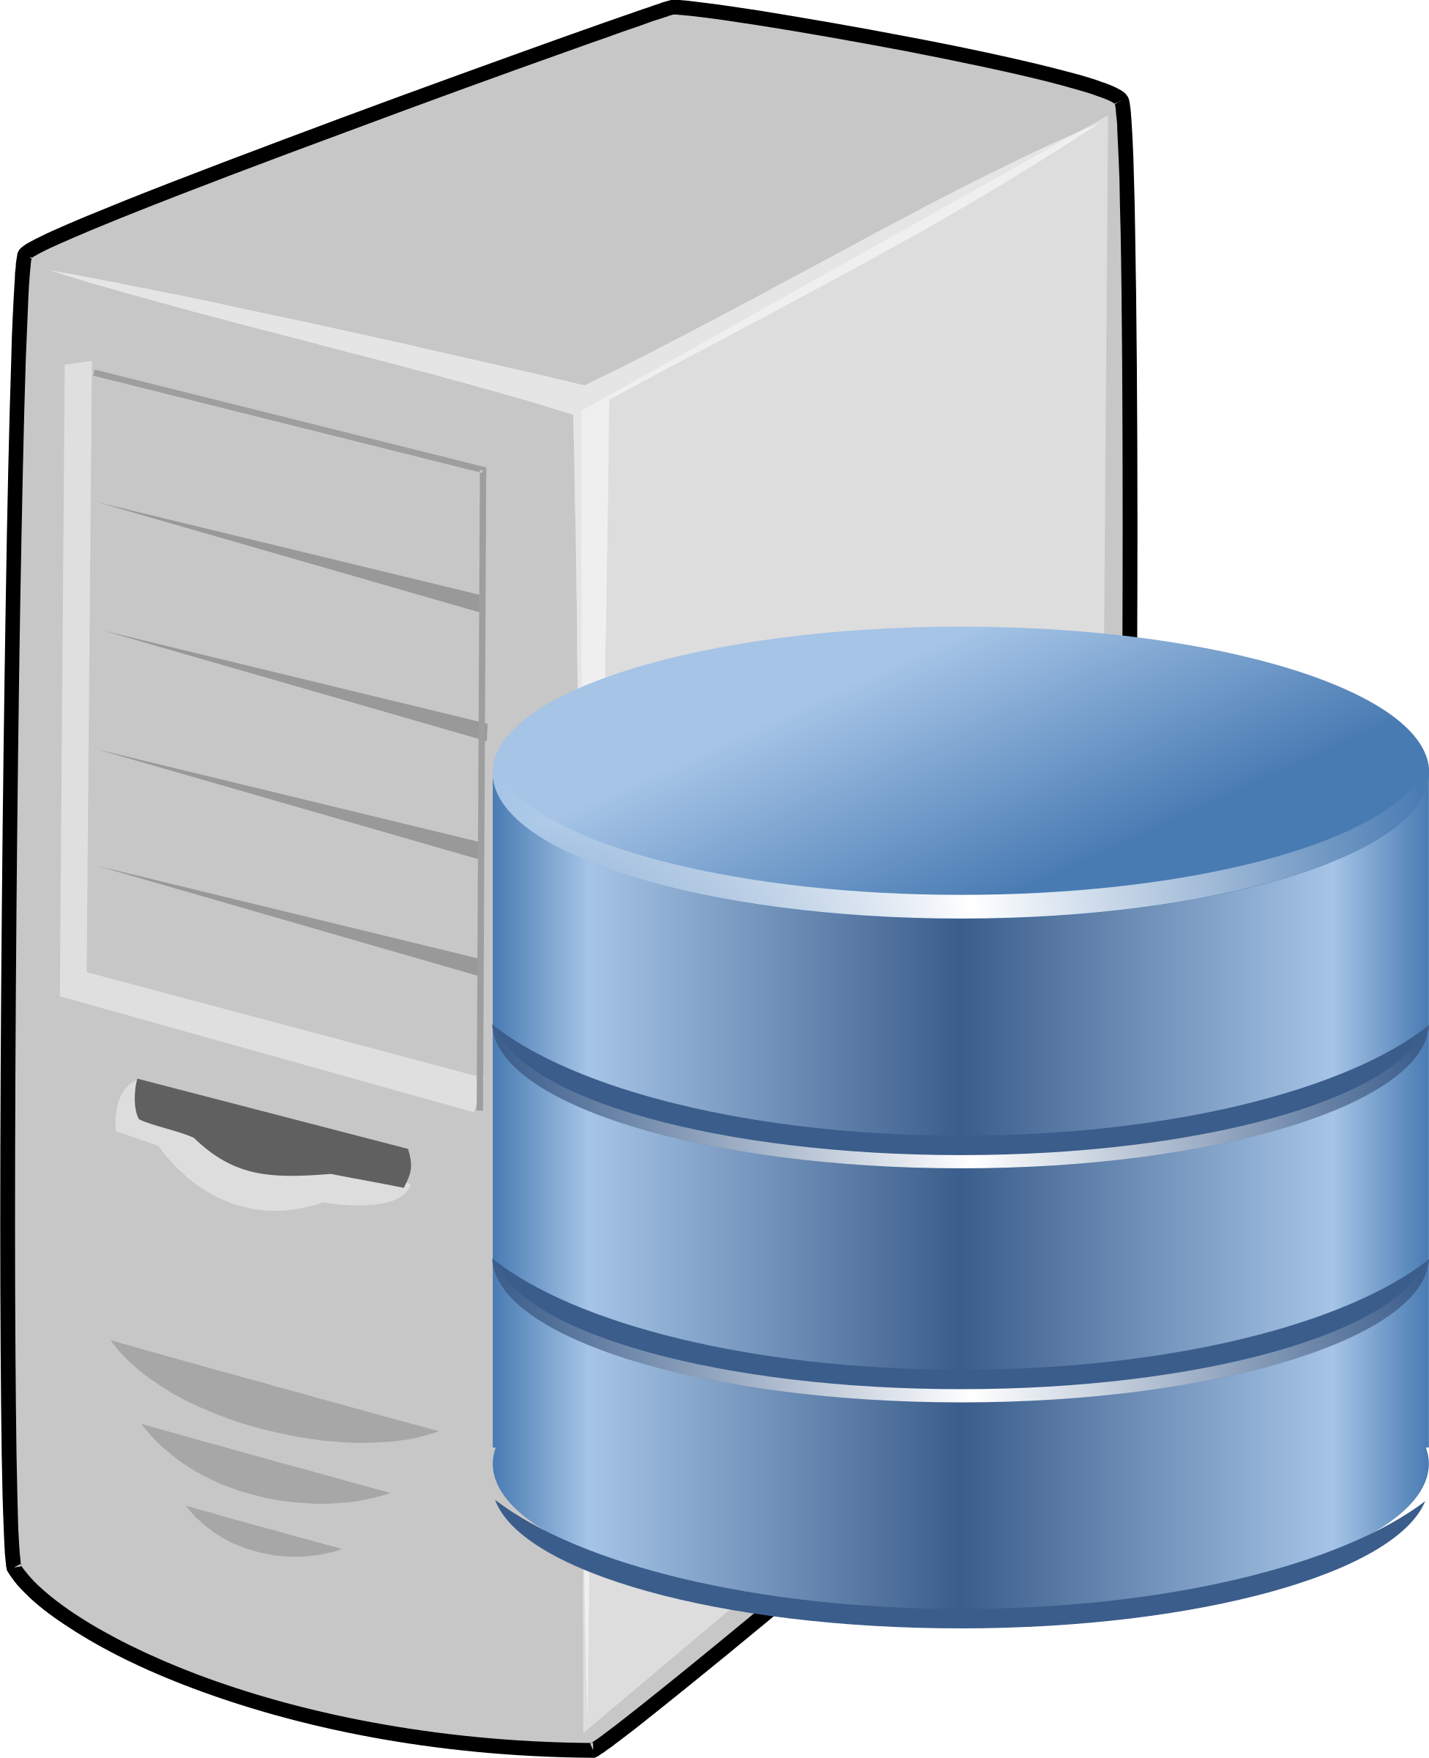
Vertical Scaling
Let’s assume that you’re starting with a very light load and you can handle all the requests on one machine. Suddenly demand increases!
The easiest approach to scaling is to just buy a faster machine to run your service.
Vertical scaling makes your machine(s) bigger and stronger.
Think “taller.”
Horizontal scaling adds more machines.
Think of them standing side-by-side.

Slide 15
COMP_ENG 101: What affects computer performance?
Primarily:
Number of CPU cores.
Speed of each CPU core.
(Lack of) competing processes running on the same machine.
https://aws.amazon.com/ec2/instance-types/
Perhaps also:
Amount of memory (RAM).
Type of disk (SSD vs magnetic).
Number of disks (parallel access).
Type of network connectivity.
Presence of GPUs, TPUs, and other special-purpose accelerators.

Slide 16
Parallelism within a machine
At any given time, you probably have about 100 processes (programs) "running" on your laptop (which probably has about 4 CPU cores).
The OS kernel schedules processes, so they take turns using CPU.
Often, processes block (wait) while doing input/output (IO).
  For example, reading a file from disk, or waiting for a message to arrive from the network.
While a process is blocked, another process can take over the CPU.
A single process can have multiple threads which execute concurrently while sharing the same memory.
  This is called Shared Memory Parallelism.

Slide 17
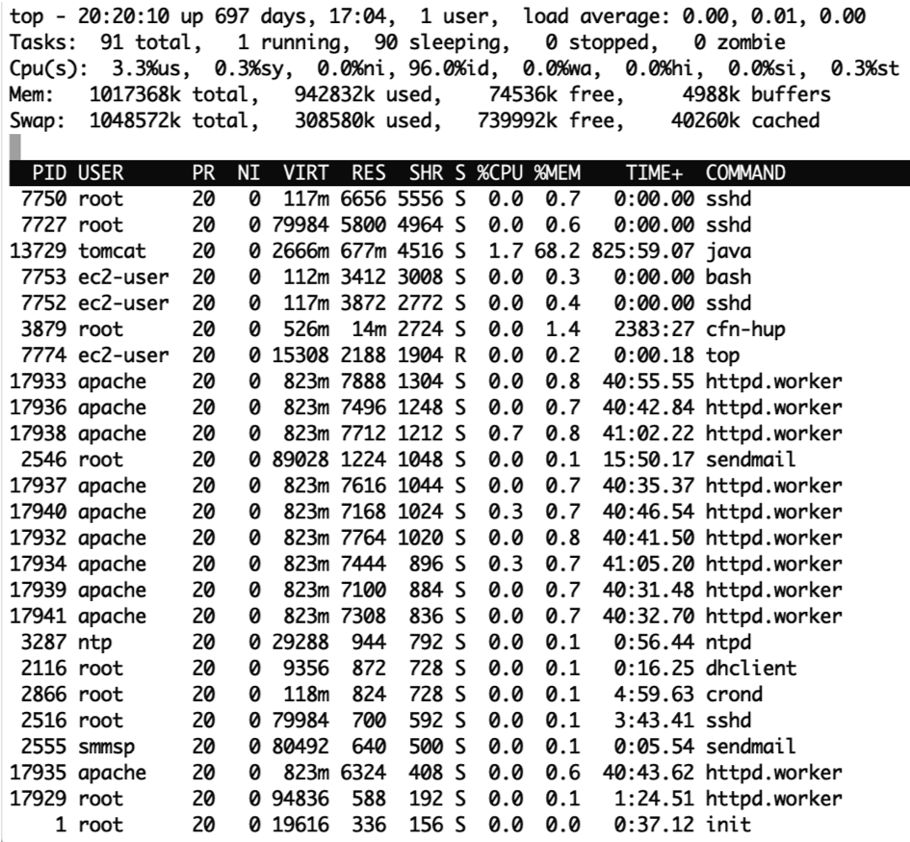
Apache web server example
At left is the output from the “top” command, showing process status on Linux.
This is a t2.micro virtual machine with only one CPU core.
It's running a webserver with at least 11 separate processes (httpd.worker).
While one process is blocked (meaning busy, eg., waiting to read data from an HTML file) another process can handle a different user’s request.

Slide 18
Cloud Computing makes scaling easier
Vertical scaling: change the instance type of a virtual machine.
Eg., upgrade from:
  t3.nano (<2 cores, 0.5GB RAM, remote SSD disk) $.0052/hour …to…
  m5d.24xlarge (96 cores, 386GB RAM, local NVMe SSD disk) $5.424/hour
Vertical scaling (up or down) just requires a reboot of the VM.
Horizontal scaling: purchase more VM instances.
  The new instance will be available to use in just a few minutes.
We call cloud computing resources “elastic” because you can quickly change the size and quantity of the computing resources you are using.

Slide 19
Vertical Scaling pros and cons
Easy to write your programs.
Most languages have support for multithreading.
Most “off the shelf” software (commercial or open source) is written to run on one machine.
  Eg.: MySQL, Oracle DB,
  Apache, Nginx, Node.js, etc
Modern servers can do a lot of work in parallel with ~96 cores.
Can connects hundreds of disks to a machine before overwhelming I/O bandwidth.
Avoids slow communication with outside machines.
Cannot handle really huge loads.
Cannot be scaled quickly in a fine-grained manner.
  Ie., must replace entire machine instead of just adding one more node.
Single point of failure.
Price/performance ratio is poor for top-of-the-line machines.
  Motherboards with many sockets are expensive.
  Fastest CPUs are expensive.
Vertical scaling is not scalable!

Slide 20
Horizontal Scaling is needed for global apps
Public Cloud Computing providers can give you lots of machines, but making good use of them is very difficult.
Most of this class will address the coordination of execution and data in horizontally-scaled systems.

Slide 21
Recap
A software service is a program that runs continuously, giving responses to requests.
Scalability is the ability of a service to grow to handle many concurrent users (ideally an arbitrarily large number).
Two approaches to scaling that are useful in different scenarios:
Vertical scaling is upgrading your machine(s).
  The simplest and most efficient way of scaling… but there is a ceiling.
Horizontal scaling is adding more machines.
  Coordinating a cluster of machines is complicated, but it's necessary for global scale and massive throughput.

